Slide 1
More Applications of Pharmacology & Toxicology
Week 4

Slide 2
Objectives 1 of 3
List the toxic constituents of tobacco smoke and describe briefly the organ specific carcinogens found in tobacco smoke.
Describe briefly the health hazards of smoking, list the causes of death attributed to tobacco smoking, and describe briefly the consequences of maternal smoking on fetus
List the common drugs of abuse.
Describe the effect of cocaine on neurotransmitters.
Describe briefly the adverse health effects of intravenous drug abuse
exogenous estrogen (Hormonal Replacement Therapy), and oral contraceptive pills.

Slide 3
Objectives 2 of 3
Define “Xenobiotics” and explain how the body prevents their actions.
Describe the disruption of normal cell functions by Xenobiotics and list the possible toxic effects of xenobiotics and examples of the target organs.
List few examples of serious risks associated with the usage of certain personal care products.
List examples of chemicals of concern in cosmetics / personal care products.
Define” Phthalates”, and describe its uses, its possible harmful effects on males and females and mention the possible routes of exposure.

Slide 4
Objectives 3 of 3
List the different mechanisms of drugs interaction. Give examples of some drugs interactions and mention their impact
Describe the health concerns of using herbal supplements and mention some example of their interactions with drugs and their possible harmful effects
Describe the categories of diet-drug interaction and mention the possible adverse effects of these interactions
Define “Endocrine disruptors”, give examples and describe their different mechanisms of action on th

Slide 5
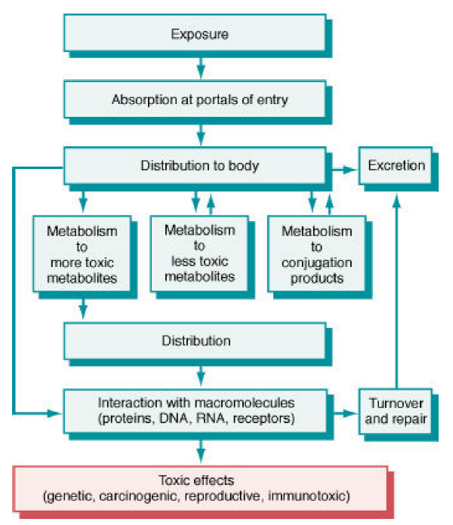
Toxicokinetics & Toxicodynamics Review

Slide 6
Personal Exposure: Tobacco
Tobacco has damaging effects on every organ in body
cancer, heart and lung disease, stroke, diabeties, COPDs, erectile dysfunction, increased risk for TB, eye disease
480,000 US deaths annually, 41,000 from 2nd hand smoke
16 million (1 in 20) Americans have smoking-related diseases
6 million die annually worldwide (to be 8 million in 2030)
Longevity of smoker reduced 10 years
17.8% (42 million) Americans are smokers (20.5% of US males, 15.3% of US females)
US Youth: 5.6 million of Americans <= 18 y age to die prematurely from smoking-related illness (1 in 13 <= 17 age alive today)
3200 young people smoke 1st cigarette every day, and 2100 per day "graduate" to regular smokers
Source: CDCP

Slide 7
Personal Exposure: Tobacco
Government (& Taxes)
States collect $25.6 billion (2015) in tobacco taxes & legal settlements but spend on $490 million (2%) on prevention & cessation programs
CDC-recommended levels of anti-smoking funding total $3.3 billion for all states, but only ND & AK fund at recommended levels and DE, OK, HI, WY, and ME fund at half recommended level
Costs
$9.17 billion in 2012 ($25 million/day, $1 million/hour) to promote smoking, heavy price discounting in industry
$300 billion/y = $170 billion direct medical costs + $156 billion lost productivity (premature death + exposure to 2nd hand smoke)
Stopping Addiction
7 in 10 adults wanted to stop smoking, 4 in 10 made attempt
100,000 expected to remain tobacco-free from a 2012 Tips From Former Smokers campaign
Sources: CDCP

Slide 8
Personal Exposure – Tobacco Use:
Smoke from a burning cigarette is a “concentrated aerosol of liquid particles suspended in an atmosphere consisting mainly of nitrogen, oxygen, carbon monoxide and carbon dioxide” *
Tar is the total particulate phase without water or nicotine
> 4000 constituents, including 43 known carcinogens
toxic & carcinogenic metals (e.g. arsenic, nickel cadmium, & chromium).
toxic promoters: acetaldehyde and phenol
toxic irritants: NO₂ & formaldehyde (HCHO)
Carbon monoxide: stronger binding affinity to heme in hemoglobin than O₂
* Guerin, Banbury Report #3 (1980)

Slide 9
Nicotine (Toxicokinetics)
pKa = 8.0 (weak base)
Absorption
Oral ingestion pH-dependent: products (chewing tobacco, snuff, nicotine gum) alkalinized to facilitate absorption in buccal mucosa
Inhalation also bypasses intestinal & hepatic metabolism
Distribution
5% plasma protein binding
Vd = 2.6 times body
autopsy samples: highest concentrations in liver, kidney, spleen lung, lowest in adipose tissue

Slide 10
Nicotine
Metabolism
Liver CYP2A6: to cotinine (compliance marker)
Other CYP and nonCYP enzymes modify functional groups
extensive metabolite products (see next slide)
Excretion
Glomerular and tubular secretion: organic cation transporters (not MDR: Pgp)
Fecal-biliary identified
Sweat

Slide 11
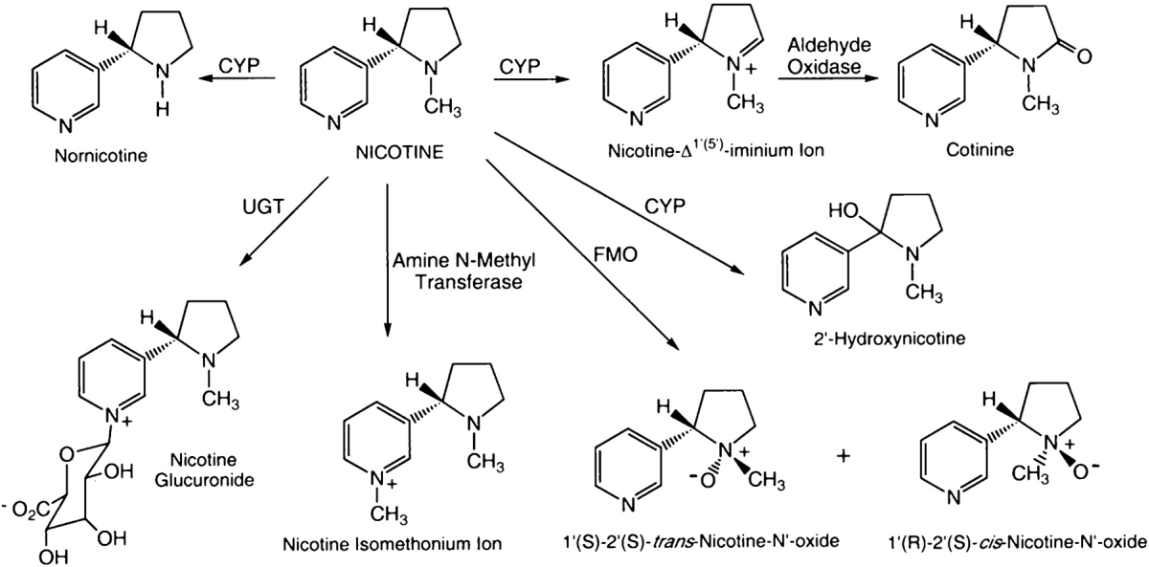
Primary biotransformation pathways identified for nicotine
Does not encompass all metabolites
http://intl.pharmrev.org/content/57/1/79.full

Slide 12
Organ Specific Carcinogens in Tobacco Smoke
Larynx, lung
polycyclic aromatic hydrocarbons (PAHs)
polonium 210
4-(methylnitrosoamino)-1-(3-pyridyl)-1-buta-none (NNK)
Esophagus
N’-Nitrosonornicotine (NNN)
Pancreas
NNK
Bladder
4-Aminobiphenyl, 2-naphthylamine
Oral cavity
smoking: PAHs NNK, NNN
snuff: NNK, NNN, polonium 210

Slide 13
Health Hazards of Smoking
The inhaled smoking agents in cigarette smoke may act directly on the –mucous membranes, may be swallowed in saliva, or may be absorbed into bloodstream from abundant alveolar capillary bed.
Inhaled smoke causes a variety of systemic diseases than can lead to death:
Carcinogenic effect: Increase in the incidence of cancer of the organs listed earlier.
Cigarette smoke act synergistically with other risk factors in the development of atherosclerosis and in turn ischemic heart disease, peripheral vascular disease and cerebrovascular accidents.

Slide 14
Health Hazards of Smoking
Respiratory tract infections, exacerbation of other lung diseases
Chronic obstructive lung disease-chronic bronchitis and emphysema
Higher rates of accidents at work place
Increases the prevalence of peptic ulcer
Effects of side-stream (passive smoking)

Slide 15
Causes of Death Attributed to Cigarette Smoking
Cancer
upper aerodigestive tract: lips, mouth, tongue, nose, throat, vocal cords, upper esophagus & trachea
lung, bladder, cervix, pancreas and stomach
Ischemic heart disease
Cerebrovascular disease
Arteriosclerosis
Chronic respiratory disease

Slide 16
Maternal Smoking Effects on Fetus & Infant
fetal hypoxia
low birth weight
premature birth
increased spontaneous abortion incidence
premature rupture of membranes
placenta previa: obstetric complication where placenta inserted partially or wholly in lower uterine segment, causes antepartum vaginal bleeding
abruptio placenta: pregnancy complication wherein placental lining separates from uterus, most common cause of late pregnancy bleeding

Slide 17
Drugs of Abuse
CNS Depressants
ethanol, barbiturates, benzodiazepines
CNS Stimulants
Cocaine, amphetamine
Narcotics
opiates: morphine, heroin, codeine
synthetic opioid: meperidine
propoxyphene
Hallucinogens/Psychedelics
marijuana, mescaline (peyote), lysergic acid diethylamide (LSD), psilocybin (mushrooms)

Slide 18
Intravenous Drug Abuse
Narcotics –overdose causes convulsions, cardiac and respiratory arrest, death
Chronic use: tolerance and dependence
All IV drug users are susceptible to infections
High incidence of HIV infection, AIDS
Four sites most commonly affected
skin and subcutaneous tissue
heart valves, liver (viral hepatitis)
lungs
Organisms causing right-sided endocarditis and tricuspid valve damage: most commonly Staphylococcus aureus; others include fungal infections (Candida) and other organisms

Slide 19
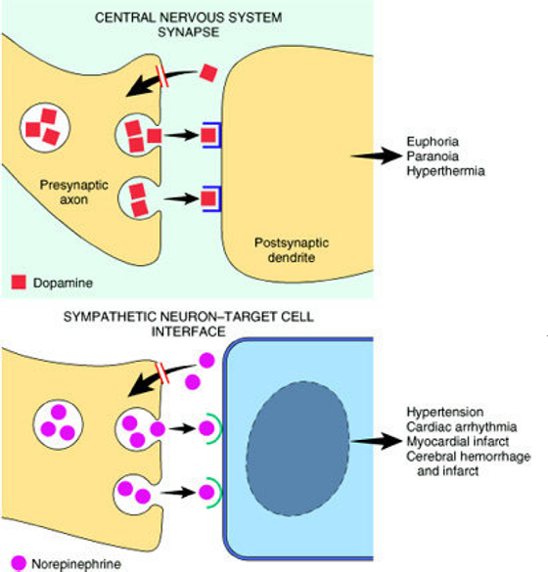
Cocaine inhibits the reuptake catecholamine dopamine transporter in the presynaptic axon terminal, which means dopamine remains in the synaptic cleft, continuing to stimulate the postsynpatic neuron
It can also inhibit reuptake of norepinephrine (NEpi) in neurons which use NEpi to stimulate effector cells and tissues, creating dangerous physiological effects

Slide 20
Therapeutic Drugs
Exogenous estrogen (hormone replacement therapy “HRT”):
Used widely in postmenopausal women
Adverse effects:
Endometrial carcinoma- increased risk
Breast carcinoma- slightly increased risk
Beneficial effects:
CVS - estrogens tend to elevate the levels of HDL, and reduce the level of LDL

Slide 21
Therapeutic Drugs
Oral contraceptives:
Adverse effects
Breast carcinoma-slight increase in the risk
Hypertension – slight increase in BP
Gall bladder disease
Thromboembolism-clearly associated with increased risk
Hepatic adenoma-well defined association with this tumor
Beneficial:
Protect against ovarian cancer

Slide 22
Xenobiotics
A xenobiotic is a chemical which is found in an organism but is not normally produced or expected to be present in it
It can also cover substances which are present in much higher concentrations than are usual. Specifically, drugs such as antibiotics are xenobiotics in humans because the human body does not produce them itself, nor are they part of a normal diet.
Natural compounds can also become xenobiotics if they are taken up by another organism, such as the uptake of natural human hormones by fish found downstream of sewage treatment plant outfalls, or the chemical defenses produced by some organisms as protection against predators

Slide 23
How Does the Body Prevent the Actions of Xenobiotics ?
1) Redistribution
2) Excretion
sites of excretion
kidney in urine
liver as water-soluble forms (conjugates) in bile
3) Metabolism – the major mechanism for terminating xenobiotic activity, and is frequently the single most important determinant of the duration and intensity of toxic responses to a xenobiotic
sites of metabolism: liver, kidney, lung, GI, and others
Note: 1) & 2) are highly dependent on 3)

Slide 24
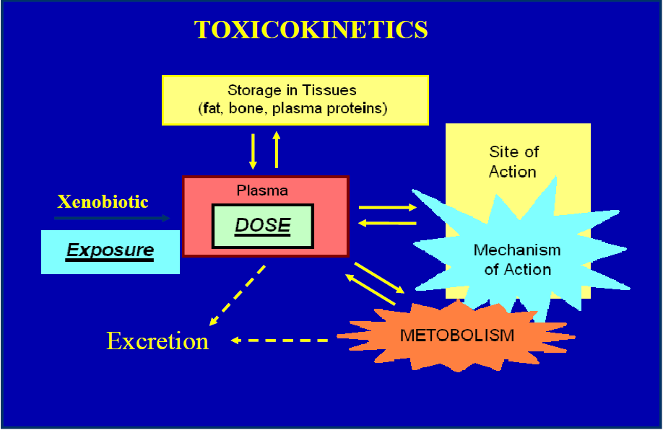

Slide 25
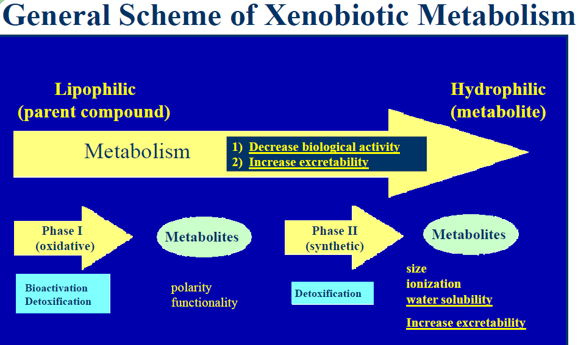

Slide 26
Personal Care Products
Why are Personal Care Products Potentially Harmful
Small-sized (low molecular weight) molecules in formulations
easy and quick dermal penetration into bloodstream
build up in organs and storage depot tissues
Is the cosmetic counter really a dangerous place?
risks and conditions: irritation or allergic reaction, swelling and lesions, contact dermatitis, flushing, headaches, dizziness, nausea, diarrhea, hair loss, and vomiting

Slide 27
Personal Care Products
More serious risks and conditions
hyper/hypo-pigmentation, violent coughing, labored breathing, eye “problems” and damage, disruption of cell development, destruction of proteins and cellular structure, premature aging, mental depression
Even more serious risks and conditions
hypoxia, narcosis
damage to immune system, respiratory system, reproductive organs, brain, liver, and kidney

Slide 28
Personal Care Products
According to industry estimates, on any given day a consumer may use as many as 25 cosmetic products containing more than 200 different chemical compounds
89% of the ingredients used personal care products have not been screened for safety by FDA or anyone else
Examples of chemicals of concern in cosmetics / personal care products:
carcinogens: acrylamide, formaldehyde, petroleum distillates–diethanolamine, 1,4-dioxane
endocrine disruptors/reproductive toxins: phthalates, parabens, toluene
neurotoxins: lead acetate, mercury.

Slide 29
Nail Salons & Their Workers
400,000 employed nationwide (96% women)
Exposed to acetone, toluene, formaldehyde, phthalates, methylacrylates, toluene sulfonamide formaldehyde (TSF) resin, and other volatile organics
Occupational Safety & Health Administration (OSHA) exposure standards do not address low-dose, long-term (chronic) exposure
State government regulation may be very inadequate
Some safer products are available -but workers may not be aware of them
Use of special ventilation products: ventilated tables

Slide 30
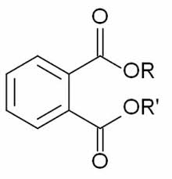
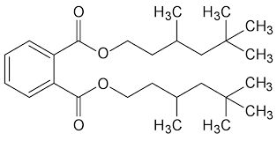
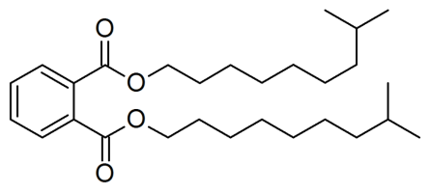
Phthalates
Chemicals softening & increasing flexibility of plastic & vinyl: polyvinyl chlorides (PVC) mixed with these to make softer
Diisononyl phthalate (DINP)
heat & cold & volatility resistance
Diisodecyl phthalate (DIDP)
used to reduce volatility, resist heat, resists aging, in electrical insulation
Dibutyl phthalate (DIBP)
ingredient in nail polish, explosives, lacquer, plastic for molds
Di-2-ethylhexyl phthalate (DEHP)
used to make PVC

Slide 31
Environmental Phthalates
Phthalates represent 80–90 % of global plasticizer consumption
Used primarily as plasticizers in polyvinyl chloride (PVC) products
Child’s toys, kitchen floors, building materials
Medical devices: Plastics in IV tubing/parts, blood bags
Perfumes: slows evaporation, makes scent last longer
Other uses: polish from chipping, hair sprays, new car smell (Partly the pungent odor of phthalates volatilizing from a hot plastic dashboard), nail extenders, bath soaps, detergents, aftershave lotions
Highest level of exposure reported for women of child-bearing age: High levels of DEP, DBP, BBP
Likely sources exposures through cosmetics: hair sprays, nail polishes and perfumes, which are common uses of DBP

Slide 32
Reproductive Development & Phthalates
Low dose levels of phthalates may produce risks for reproductive anatomy/function during development
Male experimental animals (rats) had dramatic changes in male sexual characteristics when exposed in utero to DBP & DEHP far below acute toxicity levels
Hypospadias (anomaly of the urethra ).
Damage of Sertoli cells
Low sperm count + reductions in semen quality
DNA damage to sperm.
Effects on females
Premature breast development.
Premature birth.
Carcinogenic.
At higher doses, mice and rats show liver damage

Slide 33
Drug Interactions
Drug interaction can be unidirectional or bidirectional: drug 1 can alter drug 2 ADME or each can influence each other
Classification of mechanism of interaction
Alteration in absorption
complexation/chelation e.g. antacids + tetracycline and this causes tetracycline complexes with divalent cations forming an insoluble complex
altered GI transit e.g. anticholinergics + acetaminophen and this causes delay in absorption of acetaminophen
altered gastric pH e.g. H-2 blockers + ketoconazole: dissolution of ketoconazole is decreased, resulting in reduced absorption

Slide 34
Drug Interactions
Alteration in hepatic metabolism
induction of metabolism e.g. phenobarbital + warfarin: phenobarbital increases the metabolism of warfarin, resulting in reduced anticoagulation
inhibition of metabolism e.g. cimetidine + theophylline: cimetidine reduces the clearance of theophylline causing an increase in adverse effects
Alteration in plasma protein binding e.g. phenytoin + valproic acid: protein binding of valproic acid is reduced.

Slide 35
Drug Interactions
Alteration in renal clearance
increase in renal blood flow e.g. hydralazine + digoxin: hydralazine increases the renal clearance of digoxin
inhibition of active tubular secretion e.g. probenecid + penicillin: probenecid prolongs the half-life of penicillin, allowing single dose therapy
alterations in tubular reabsorption e.g. antacids + aspirin: antacids reduce the tubular reabsorption of salicylate via an increase in urine pH

Slide 36
Herbs / Herbal Products
Widespread consumer use as dietary supplements
Not controlled by FDA if not marketed to prevent, diagnose, cure, treat, or mitigate disease
If FDA can show "unsafe," can remove from market
Efficacy
Many salutary benefits claims unproven
Limited studies support traditional use/benefits
Safety
GRAS: natural forms Generally Regarded As Safe
Variations in preparations may produce toxic form

Slide 37
Herbs / Herbal Products
Interactions
Some could prolong or inhibit actions of other herbs or drugs
Contamination
some products found to contain lead & other toxic metals, even added, to the preparation
other contaminants include molds, bacteria, pesticides
Adulteration of imported products, including addition of synthetic drugs not identified on labels

Slide 38
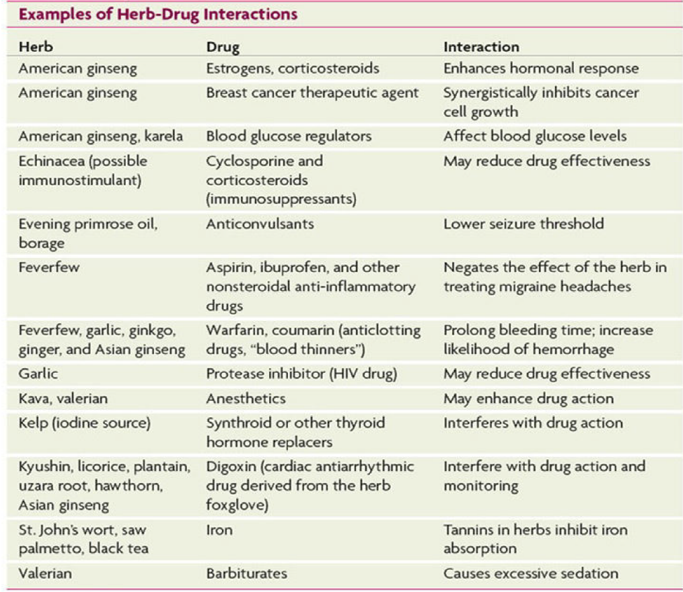

Slide 39
Drug-Diet Interaction
Diet-drug interactions fall into the following categories:
Medications can alter food intake by suppressing appetite or causing complications that interfere with food intake.
Medications can alter absorption, metabolism & excretion of nutrients.
Nutrients & other food components can alter absorption, metabolism & excretion of medications.
Some interactions between food components & medications can be toxic

Slide 40
Effects of Drug on Diet
Drug effects on food ingestion
nausea & vomiting affecting appetite
alteration of taste sensations
dry mouth
inflammation or lesions in mouth or GI tract
abdominal discomfort
constipation
diarrhea
drowsiness

Slide 41
Effects of Drug on Diet
Drug effects on nutrient absorption
antineoplastic & antiretroviral medications: damage of intestinal mucosa
ciprofloxacin: prevents nutrient absorption
antacids: reduced gastric acidity lowers absorption of vitamin B₁₂, folate & iron
some drugs interfere with absorption of intestinal transporters
Drug effects on nutrient metabolism
methotrexate: inhibits folate-mediated metabolism
Drug effects on nutrient excretion
reduced mineral reabsorption in kidney tubules
increased excretion of vitamins, minerals (vit B₆)

Slide 42
Dietary Effects
Dietary effects on drug absorption:
Stomach emptying rate taking medications on empty stomach tends to increase absorption rate; taking medications on full stomach may delay its absorption rate (ex. Aspirin).
Stomach acidity absorption rates affected by acid or alkaline medium
Interactions with food components: may bind with drugs & inhibit absorption.

Slide 43
Dietary Effects
Dietary effects on drug metabolism:
alteration in activities of enzymes that metabolize drugs
increased blood concentration of drug (stronger physiological effects): e.g. grapefruit and statins (lipid lowering drugs).
Decreased effectiveness of drug e.g. warfarin and Vit. K
Counteraction of drug effects in other ways

Slide 44
Alterations in excretion causing toxicity or reduced effectiveness of the drug:
Increased or decreased reabsorption (e.g. Li and Na).
Alterations in drug actions
Diet-drug interactions & toxicity
interactions can result in toxicity or exacerbate drug side effects e.g. MAOIs “antidepressants” potentiates the pressor effect of the monoamine tyramine ”found in cheese”
Health professions must understand mechanism of action of drugs & diet-drug interactions for identification &/or prevention.

Slide 45
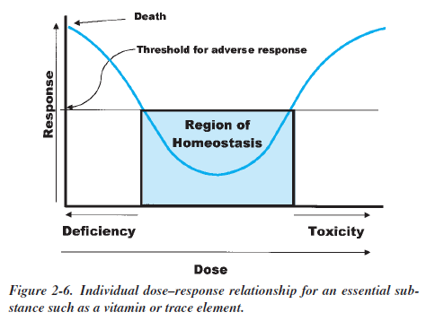
Vitamins & Minerals
Vita "life" + amin(e) "amino acid"
The essential drug: deficiency as bad as overdose
Coenzymes in countless metabolic pathways, including detoxifying reactions (NAD, FAD/FMN)
Author of Vitamania C Price: The healthiest and safest doses of vitamins are the ones naturally occurring in foods

Slide 46
Supplementation Industry Facts
$18 billion with 7% avg annual growth 2010-2015
1031 businesses employing 27,000
Vitamin & mineral supplements may be prescribed in pathological deficiencies
At least no harmful effect with overdosing most (water-soluble) vitamins
Fat-soluble vitamin A and D could present problem in overdosing (hypervitaminosis)
sources: IBISWorld

Slide 47
Endocrine Disruptors
Any chemical agent in the environment that can alter normal endocrine system actions leading to deleterious effects on an organism or its progeny
Direct-acting disruptors
hormone or hormone-like agonists or antagonists interfering with hormone actions on target cells, interacting with receptors or effecting physiological activity
Indirect-acting disruptors
alter hormone dynamics in circulation, change hormone metabolism, or interfere with hormone regulation

Slide 48
Examples of Endocrine Disruptors
Pesticides: herbicides, insecticides
Plasticizers
Natural plant metabolites
Pharmaceuticals: contraceptives, drugs
Detergents
Chemicals from cooking & burning
Antibiotics
Metals

Slide 49
Effects of Endocrine Disruptors
Inability to maintain homeostasis
Altered growth & development
Altered responses to external stimuli
Altered behavior
Suppressed gametogenesis
Elevated gestational losses
Embryonic malformation
Induced neoplasia or carcinogenesis

Slide 50
Mechanism of Endocrine Disruption
Receptor Mediated
Agonistic & Antagonistic
Pesticides
Polychlorinated biphenyls (PCBs)
Altered Enzyme Action
Nitrate/nitrite
Pesticides
Phthalates
Altered Metabolism
Pesticides
Altered Hormone Availability
PCBs/ Polybrominated biphenyls (PBBs)
Altered Gene Expression
Nitrates/nitrite
Pesticides
PCBs

Slide 51
Endocrine Disruption Effects on Females
Impaired fertility
Endocrine dysfunction: altered hormone profiles
Reproductive system structure alteration
increasing incidence of uterine and oviduct abnormalities
Brain and behavior
altered IQ and behavior, including sexual behaviors
Cancer
increasing incidence of breast, ovarian, and uterine cancers
Endometriosis
abnormal outgrowth of endometrial tissue beyond uterus
Age at which puberty is reached
Immune dysfunction
Multigenerational effects

Slide 52
Effects on Males
Declining fertility
fall in sperm count
Endocrine dysfunction
altered hormone profiles
Reproductive system structure alteration
increasing incidence of hypospadias (urethral opening not at penis tip but underside) and cryptorchidism (undescended testes)
Brain and behavior
same as for female
Cancer
increasing incidence of testicular & prostate cancers
Age of Puberty.
Immune dysfunction.
Multigenerational effects

Slide 53
Metabolic Impact
Toxicants disrupt metabolic pathways
Specific enzymes in the pathway
Altering proteins that may provide structure or function of vital organelles
Mitochondrial Dysfunction

Slide 54
Genomic Impact
Toxicants (or their metabolites = OTM) can enter nucleus and directly chemically modify DNA directly
Toxicants OTM can alter other biochemicals that can modify DNA detrimentally
Toxicants can alter the function of enzymes that maintain correct coding of DNA or its expression (DNA repair enzymes, RNA transcribing enzymes)
Any of these can lead to altered cell biology or to cell death
Altered cell biology includes loss of cells' ability to control its replication → cancer

Slide 55
Systems Biology (OMICS)
Science now attempts to get a larger picture (the "whole picture") of what happens in diseased/disordered states, and compare it to healthy states
It does this by doing experiments and assays to qualitatively and quantitatively determine all the RNA, proteins, and metabolites that are present during a disease state or after a toxicant is administered
The catalog of these molecules represents the transcriptome, the proteome, and the metabolome, respectively, of cells and tissues. Comparative assessments are done against what is regarded as healthy
This global analysis

Slide 56
Holistic Management
Holistic medicine – healing taking into account the "whole person": body, mind, spirit, emotions
If one part in disorder, then all parts affected
Patient-centered wellness: diet, exercise, psychotherapy/relationship-spiritual counseling, etc
"Complementary & alternative therapies": acupuncture, chiropractic care, homeopathy, massage/aroma therapy, naturopathy, etc
"Western medications, surgical procedures"
Practitioners: DCs, MDs, DOs, DOMs/DAOMs, NDs/NMDs, LAcs
Academy of Integrative Health & Medicine (AIHM, formerly American Holistic Medicine Association)

Slide 57
Chiropractic Medicine
American Chiropractic Association House of Delegates recently passed a resolution calling for "prescriptive authority" and for establishment of College of Pharmacology & Toxicology, but do not endorse the use of pharmaceuticals in the approach to health care

Slide 58
Philosophy of Chiropractic Med
70% of Americans now take at least one prescription drug
Many healing approaches
What should be the first approach ("resort")?
Last resort?
What are your obligations in discussing the resolution to the patient's chief complaint?

Slide 59
Government & Toxicology
United States (Federal) Government
Environmental Protection Agency (EPA)
Clean Air
Clean Water
Food & Drug Administration (FDA)
Safety
Efficacy

Slide 60
Government & Toxicology
California (State) Government
Environmental Protection Agency (CalEPA)
Air Resources Board (ARB)

Slide 61
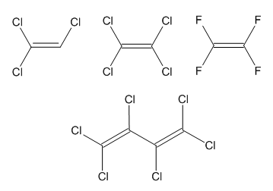
Nephrotoxic Solvents
trichloroethylene, perchloroethylene, hexachlorobutadiene, tetrafluoroethylene,

Slide 62
Ionizing Radiation
low and high level radioisotopes
electromagnetic fields (EMFs)

